Slide 1
Translation of English to Mauritian Creole

Slide 2
Introduction
The translation of English to Mauritian Creole is part of the field of Natural Language Processing. It is also known as Machine Translation which is the task of automatically converting one natural language into another, preserving the meaning of the input text, and producing fluent text in the output language. Machine Translation is one of the oldest subfields of artificial intelligence research.

Slide 3
Problem Statement
No available tools that exist to translate English to Mauritian Creole
The need to have an algorithm that can be able to perform translations in an efficient and accurate manner since the translation of English to Mauritian Creole is a very complex task

Slide 4
Rationale of the study
The study will be undertaken to better understand the needs of having English to Mauritian Creole translation in the Mauritian society and also to better know the targeted audience for such a tool in Mauritius
A survey will be conducted amongst different people coming from different backgrounds and having different IT skills.
The survey will help us know to what extent people are using Machine Translation systems and the amount of times they use such tools.

Slide 5
Aims & Objectives of Project
For the study, we will be performing research on existing translation tools already available. Also we will compare different algorithms for Natural Language Translation. Finally at the end of the project, I expect to have a tool that will help to perform translation of English language to Mauritian Creole language.

Slide 6
Some existing tools
Babelfish – A tool that has been developed by Yahoo! and has now been replaced by Bing Translator.
Bing Translator - previously Live Search Translator and Windows Live Translator.
Google Translate

Slide 7
Expected Output
At the end of the project, we will be expecting to have a working tool to perform translation of English to Mauritian Creole.

Slide 8
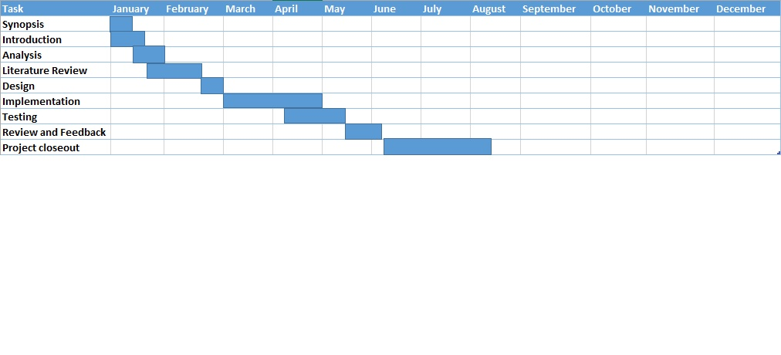
Research plan (Time Frame)/Activity (Gantt) Chart

Slide 9

Question and Answers

